Slide 1
L.O.
Reflect on speaking and listening assessment (AF3 S&L)
Did you:
6 - Make careful choices in speech, gesture, and movement?
7 - Explore complex ideas and issues?
8 - Experiment with complex roles/scenarios?

Slide 2
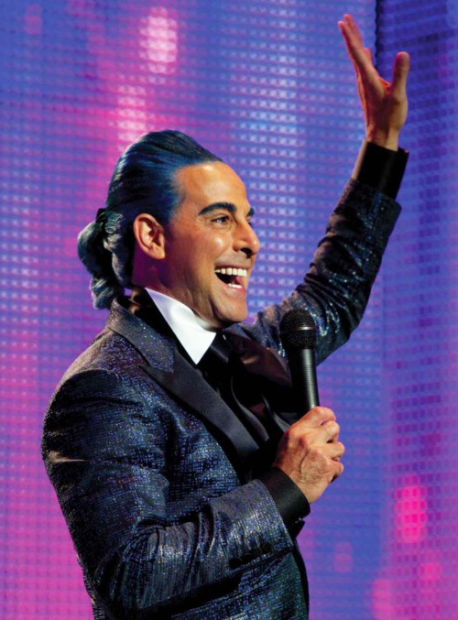
In your assessment books:
Summarise the role you played
Self assess using the APP S&L Grid (AF3)
Set a target to improve
On laptops:
- Edit your interviews together (the video files will be in dropbox)

Slide 3
In the Dropbox, there is a folder for each of your Districts.
You need to watch the video file in there which contains your interview assessments from last lesson.
You need to use these videos to help you with your Red for Reflection in your assessment books.

